Slide 1
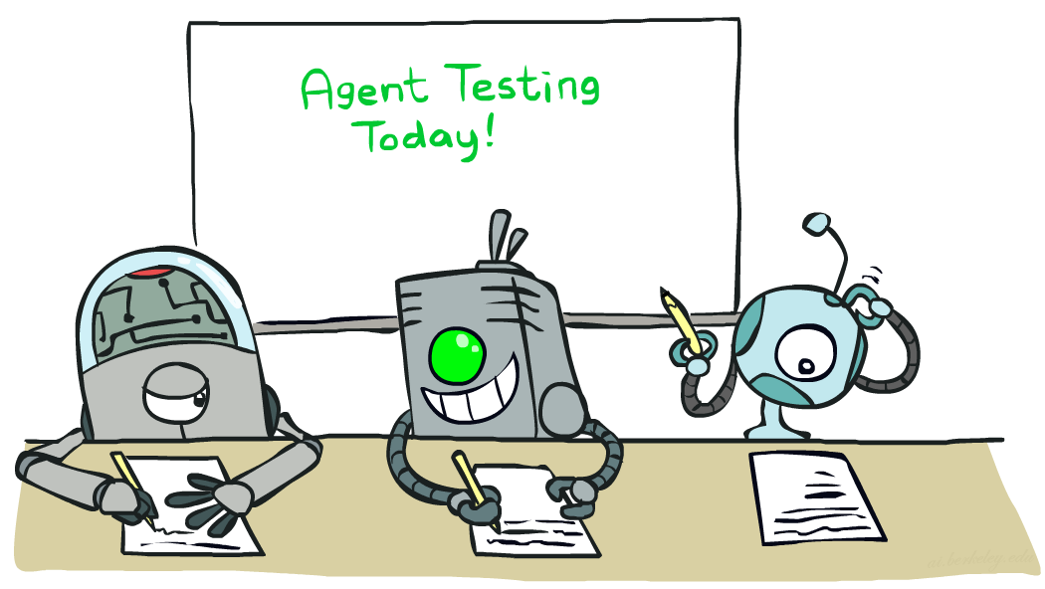

CSE 317: Artificial Intelligence
Naïve Bayes
[These slides were created by Dan Klein and Pieter Abbeel for CS188 Intro to AI at UC Berkeley. All CS188 materials are available at http://ai.berkeley.edu.]
Notes:
Please retain proper attribution, including the reference to ai.berkeley.edu. Thanks!

Slide 2
Machine Learning
Up until now: how use a model to make optimal decisions
Machine learning: how to acquire a model from data / experience
Learning parameters (e.g. probabilities)
Learning structure (e.g. BN graphs)
Learning hidden concepts (e.g. clustering)
Today: model-based classification with Naive Bayes

Slide 3
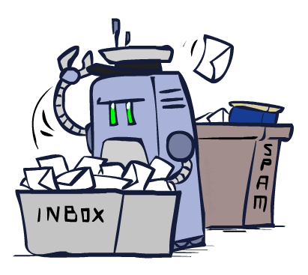
Classification

Slide 4
Example: Spam Filter
Input: an email
Output: spam/ham
Setup:
Get a large collection of example emails, each labeled “spam” or “ham”
Note: someone has to hand label all this data!
Want to learn to predict labels of new, future emails
Features: The attributes used to make the ham / spam decision
Words: FREE!
Text Patterns: $dd, CAPS
Non-text: SenderInContacts
…
Dear Sir.
First, I must solicit your confidence in this transaction, this is by virture of its nature as being utterly confidencial and top secret. …
TO BE REMOVED FROM FUTURE MAILINGS, SIMPLY REPLY TO THIS MESSAGE AND PUT "REMOVE" IN THE SUBJECT.
99 MILLION EMAIL ADDRESSES
FOR ONLY $99
Ok, Iknow this is blatantly OT but I'm beginning to go insane. Had an old Dell Dimension XPS sitting in the corner and decided to put it to use, I know it was working pre being stuck in the corner, but when I plugged it in, hit the power nothing happened.

Slide 5
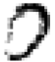
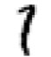
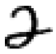

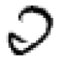
Example: Digit Recognition
Input: images / pixel grids
Output: a digit 0-9
Setup:
Get a large collection of example images, each labeled with a digit
Note: someone has to hand label all this data!
Want to learn to predict labels of new, future digit images
Features: The attributes used to make the digit decision
Pixels: (6,8)=ON
Shape Patterns: NumComponents, AspectRatio, NumLoops
…
0
1
2
1
??

Slide 6
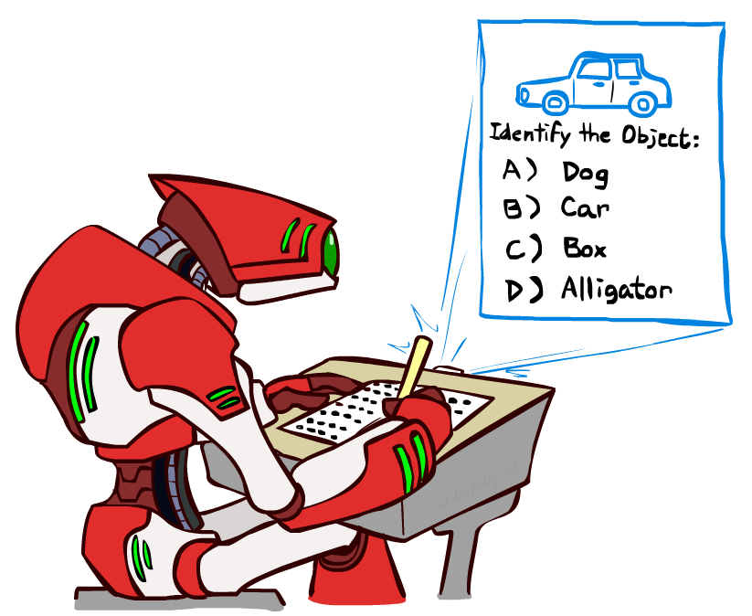
Other Classification Tasks
Classification: given inputs x, predict labels (classes) y
Examples:
Spam detection (input: document,
classes: spam / ham)
OCR (input: images, classes: characters)
Medical diagnosis (input: symptoms,
classes: diseases)
Automatic essay grading (input: document,
classes: grades)
Fraud detection (input: account activity,
classes: fraud / no fraud)
Customer service email routing
… many more
Classification is an important commercial technology!

Slide 7
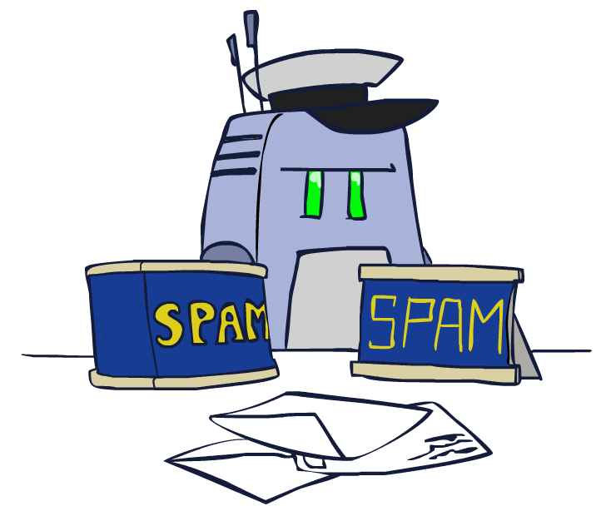
Model-Based Classification

Slide 8
Model-Based Classification
Model-based approach
Build a model (e.g. Bayes’ net) where both the label and features are random variables
Instantiate any observed features
Query for the distribution of the label conditioned on the features
Challenges
What structure should the BN have?
How should we learn its parameters?

Slide 9

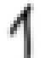
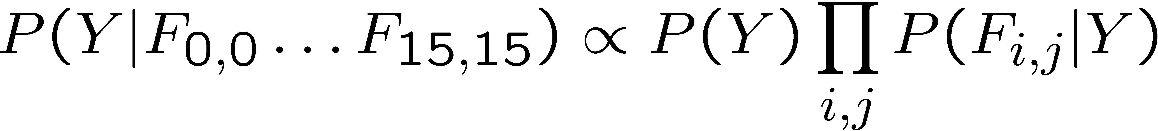
Naïve Bayes for Digits
Naïve Bayes: Assume all features are independent effects of the label
Simple digit recognition version:
One feature (variable) F_{ij} for each grid position <i,j>
Feature values are on / off, based on whether intensity
is more or less than 0.5 in underlying image
Each input maps to a feature vector, e.g.
Here: lots of features, each is binary valued
Naïve Bayes model:
What do we need to learn?
Y
F₁
F₂
F_{n}

Slide 10
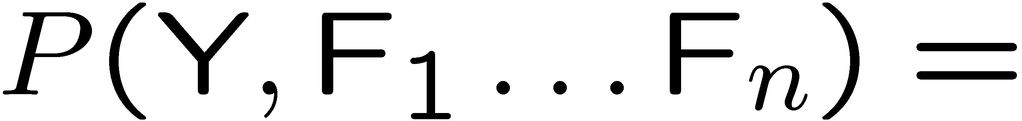
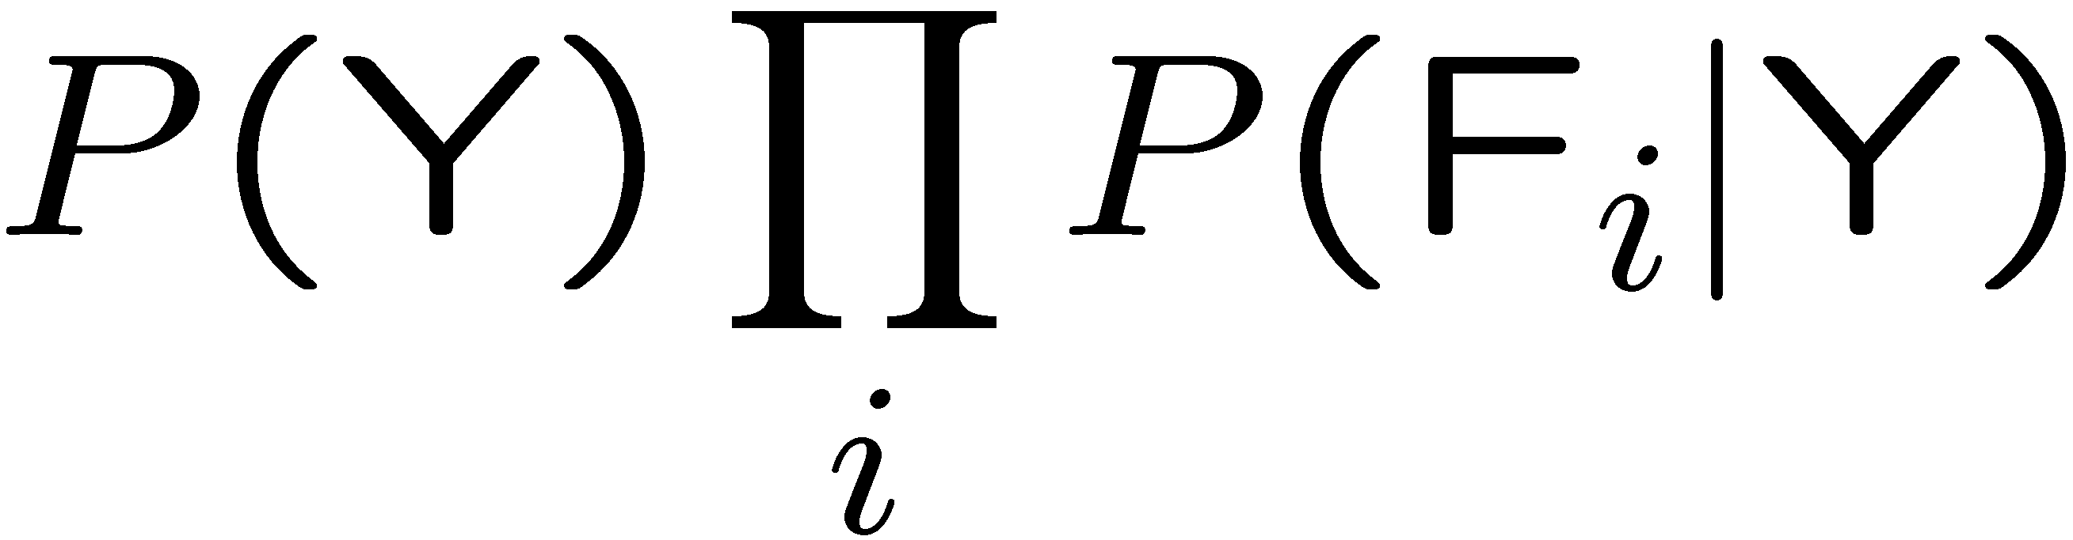
General Naïve Bayes
A general Naive Bayes model:
We only have to specify how each feature depends on the class
Total number of parameters is linear in n
Model is very simplistic, but often works anyway
Y
|Y| parameters
F₁
F₂
F_{n}
|Y| x |F|^{n} values
n x |F| x |Y| parameters

Slide 11
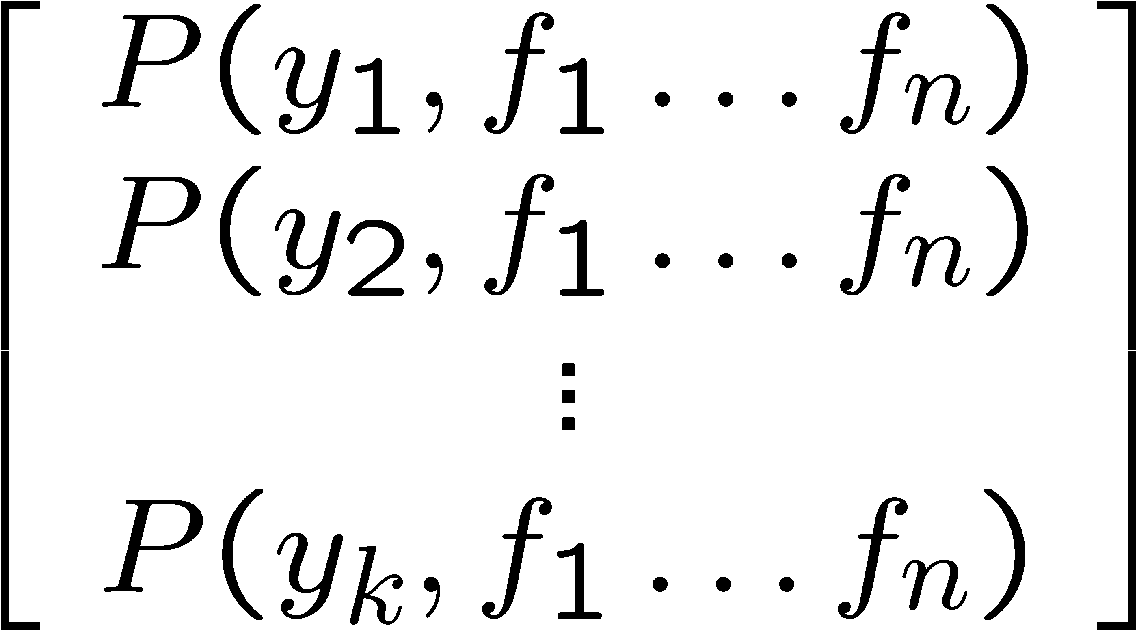
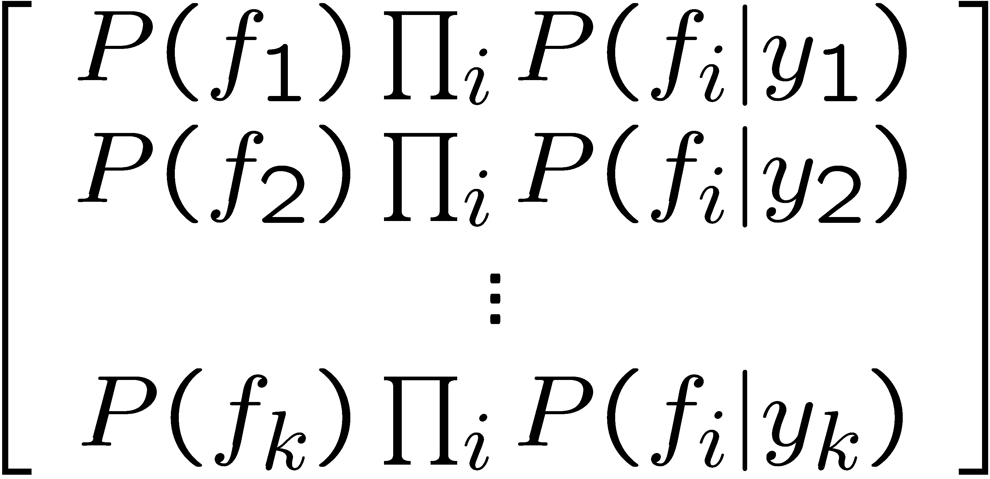
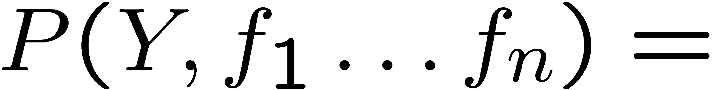
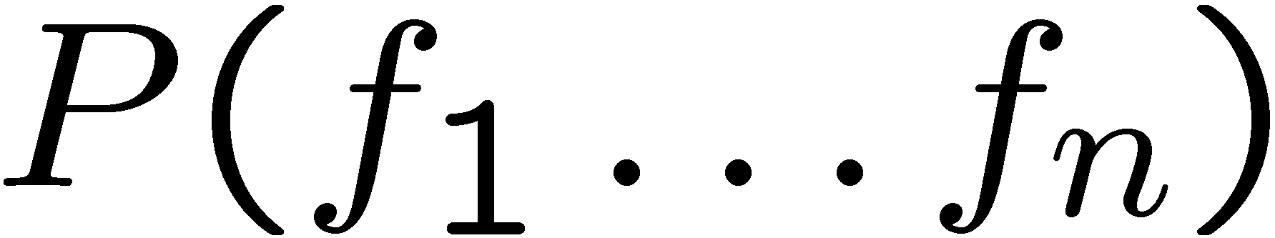
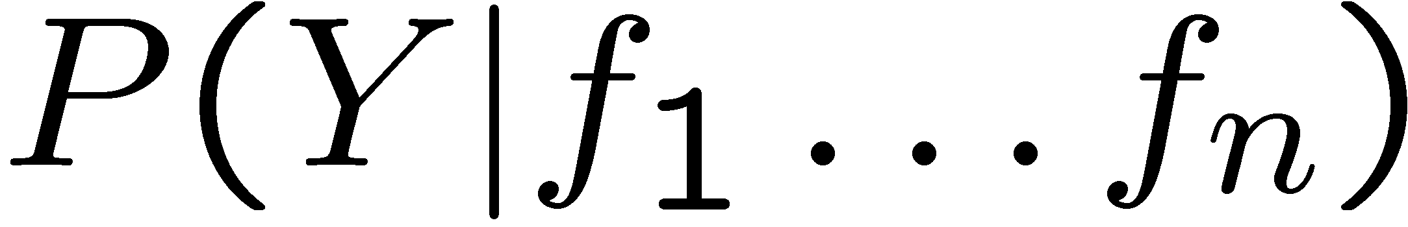
Inference for Naïve Bayes
Goal: compute posterior distribution over label variable Y
Step 1: get joint probability of label and evidence for each label
Step 2: sum to get probability of evidence
Step 3: normalize by dividing Step 1 by Step 2
+

Slide 12
General Naïve Bayes
What do we need in order to use Naïve Bayes?
Inference method (we just saw this part)
Start with a bunch of probabilities: P(Y) and the P(F_{i}|Y) tables
Use standard inference to compute P(Y|F₁…F_{n})
Nothing new here
Estimates of local conditional probability tables
P(Y), the prior over labels
P(F_{i}|Y) for each feature (evidence variable)
These probabilities are collectively called the parameters of the model and denoted by θ
Up until now, we assumed these appeared by magic, but…
…they typically come from training data counts: we’ll look at this soon

Slide 13
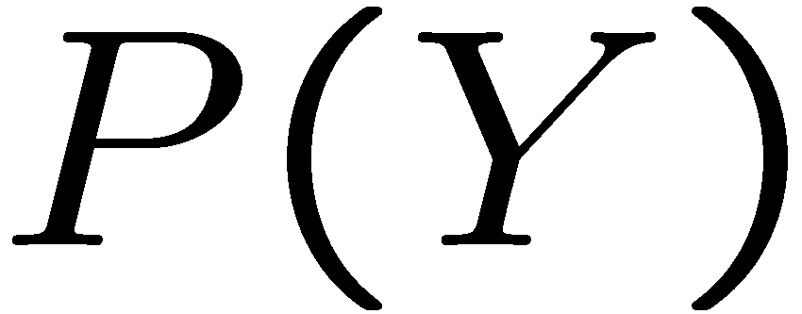
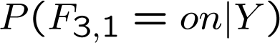
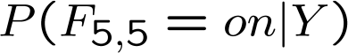
Example: Conditional Probabilities
1 | 0.1
2 | 0.1
3 | 0.1
4 | 0.1
5 | 0.1
6 | 0.1
7 | 0.1
8 | 0.1
9 | 0.1
0 | 0.1
1 | 0.01
2 | 0.05
3 | 0.05
4 | 0.30
5 | 0.80
6 | 0.90
7 | 0.05
8 | 0.60
9 | 0.50
0 | 0.80
1 | 0.05
2 | 0.01
3 | 0.90
4 | 0.80
5 | 0.90
6 | 0.90
7 | 0.25
8 | 0.85
9 | 0.60
0 | 0.80

Slide 14
A Spam Filter
Naïve Bayes spam filter
Data:
Collection of emails, labeled spam or ham
Note: someone has to hand label all this data!
Split into training, held-out, test sets
Classifiers
Learn on the training set
(Tune it on a held-out set)
Test it on new emails
Dear Sir.
First, I must solicit your confidence in this transaction, this is by virture of its nature as being utterly confidencial and top secret. …
TO BE REMOVED FROM FUTURE MAILINGS, SIMPLY REPLY TO THIS MESSAGE AND PUT "REMOVE" IN THE SUBJECT.
99 MILLION EMAIL ADDRESSES
FOR ONLY $99
Ok, Iknow this is blatantly OT but I'm beginning to go insane. Had an old Dell Dimension XPS sitting in the corner and decided to put it to use, I know it was working pre being stuck in the corner, but when I plugged it in, hit the power nothing happened.

Slide 15
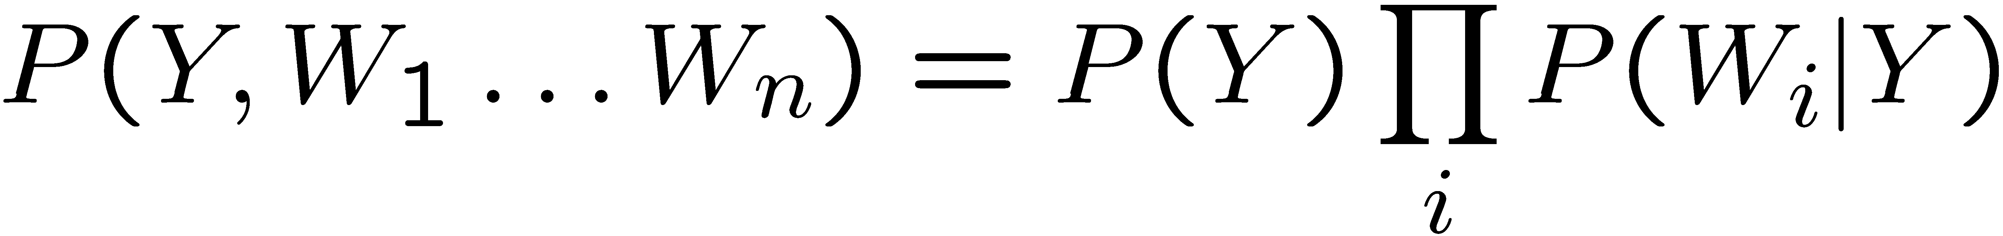
Naïve Bayes for Text
Bag-of-words Naïve Bayes:
Features: W_{i} is the word at positon i
As before: predict label conditioned on feature variables (spam vs. ham)
As before: assume features are conditionally independent given label
New: each W_{i} is identically distributed
Generative model:
“Tied” distributions and bag-of-words
Usually, each variable gets its own conditional probability distribution P(F|Y)
In a bag-of-words model
Each position is identically distributed
All positions share the same conditional probs P(W|Y)
Why make this assumption?
Called “bag-of-words” because model is insensitive to word order or reordering
Word at position i, not i^{th} word in the dictionary!

Slide 16

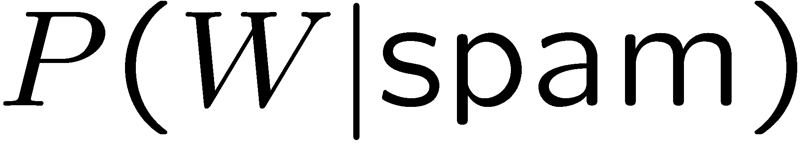
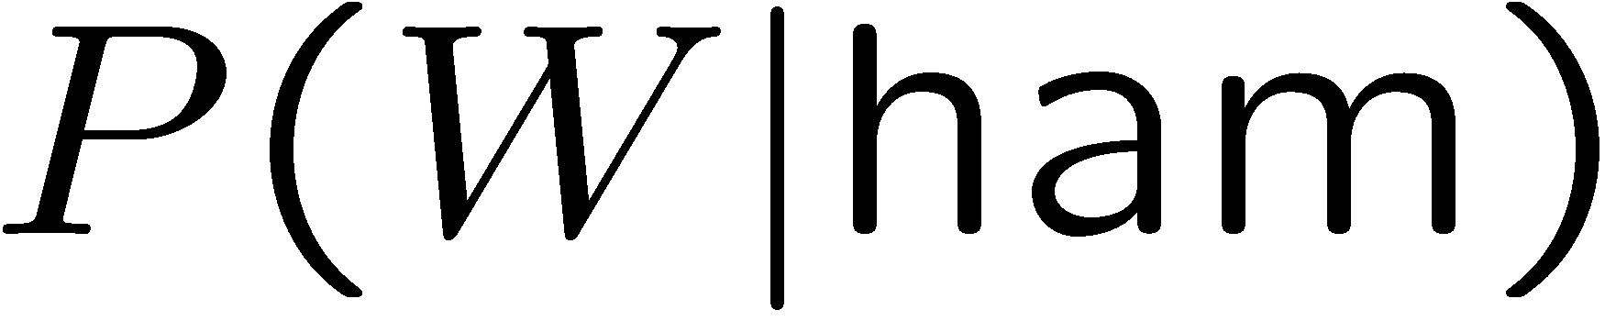
Example: Spam Filtering
Model:
What are the parameters?
Where do these tables come from?
ham : 0.66
spam: 0.33
the : 0.0156
to : 0.0153
and : 0.0115
of : 0.0095
you : 0.0093
a : 0.0086
with: 0.0080
from: 0.0075
...
the : 0.0210
to : 0.0133
of : 0.0119
2002: 0.0110
with: 0.0108
from: 0.0107
and : 0.0105
a : 0.0100
...

Slide 17
Spam Example
Word | P(w|spam) | P(w|ham) | Tot Spam | Tot Ham
(prior) | 0.33333 | 0.66666 | -1.1 | -0.4
Gary | 0.00002 | 0.00021 | -11.8 | -8.9
would | 0.00069 | 0.00084 | -19.1 | -16.0
you | 0.00881 | 0.00304 | -23.8 | -21.8
like | 0.00086 | 0.00083 | -30.9 | -28.9
to | 0.01517 | 0.01339 | -35.1 | -33.2
lose | 0.00008 | 0.00002 | -44.5 | -44.0
weight | 0.00016 | 0.00002 | -53.3 | -55.0
while | 0.00027 | 0.00027 | -61.5 | -63.2
you | 0.00881 | 0.00304 | -66.2 | -69.0
sleep | 0.00006 | 0.00001 | -76.0 | -80.5
P(spam | w) = 98.9

Slide 18
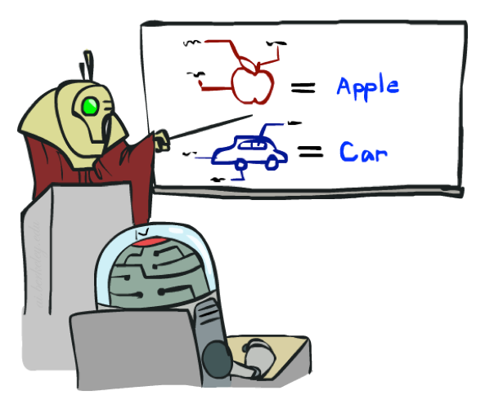
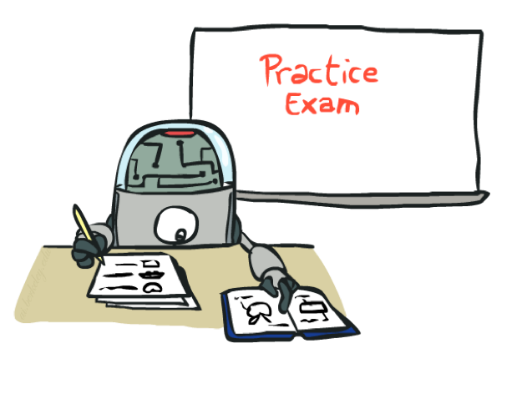
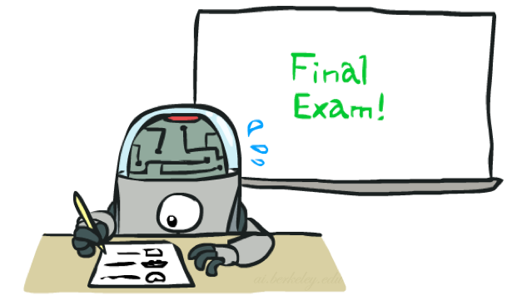
Training and Testing

Slide 19


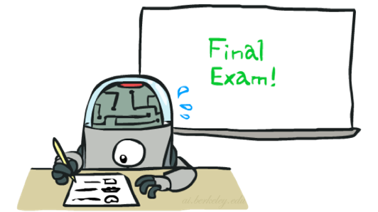
Important Concepts
Data: labeled instances, e.g. emails marked spam/ham
Training set
Held out set
Test set
Features: attribute-value pairs which characterize each x
Experimentation cycle
Learn parameters (e.g. model probabilities) on training set
(Tune hyperparameters on held-out set)
Compute accuracy of test set
Very important: never “peek” at the test set!
Evaluation
Accuracy: fraction of instances predicted correctly
Overfitting and generalization
Want a classifier which does well on test data
Overfitting: fitting the training data very closely, but not generalizing well
We’ll investigate overfitting and generalization formally in a few lectures
Training
Data
Held-Out
Data
Test
Data

Slide 20

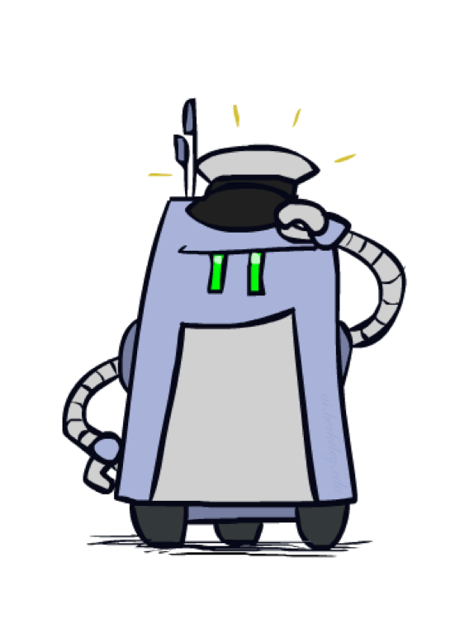
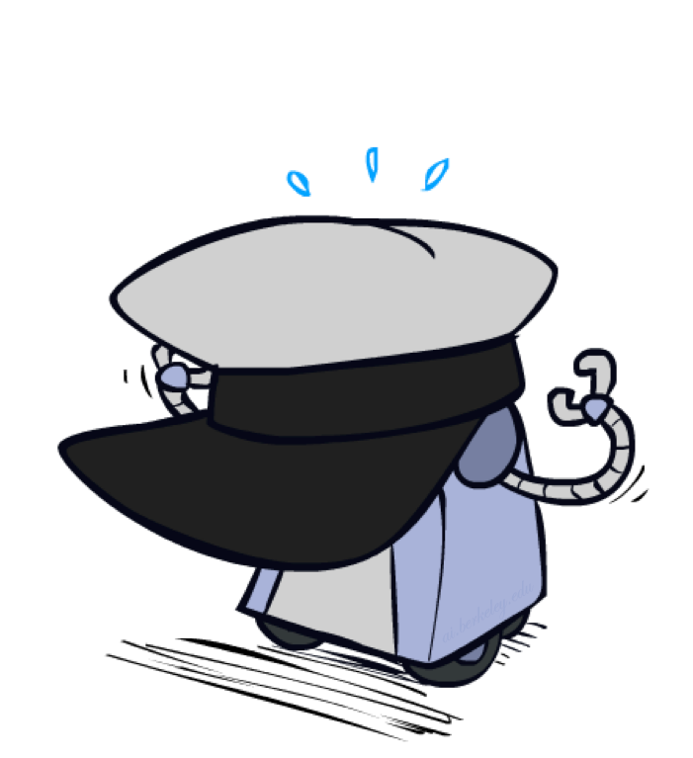
Generalization and Overfitting

Slide 21
Overfitting
30
25
20
Degree 15 polynomial
15
10
5
0
-5
-10
-15
0
2
4
6
8
10
12
14
16
18
20

Slide 22
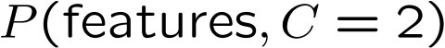
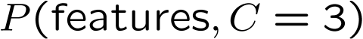
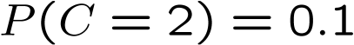
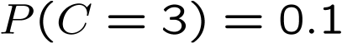
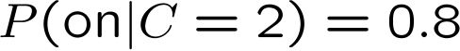
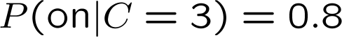
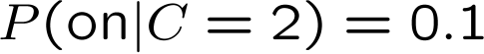
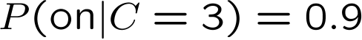
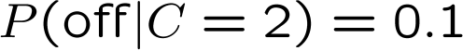
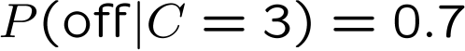
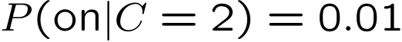
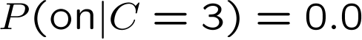
Example: Overfitting
2 wins!!

Slide 23
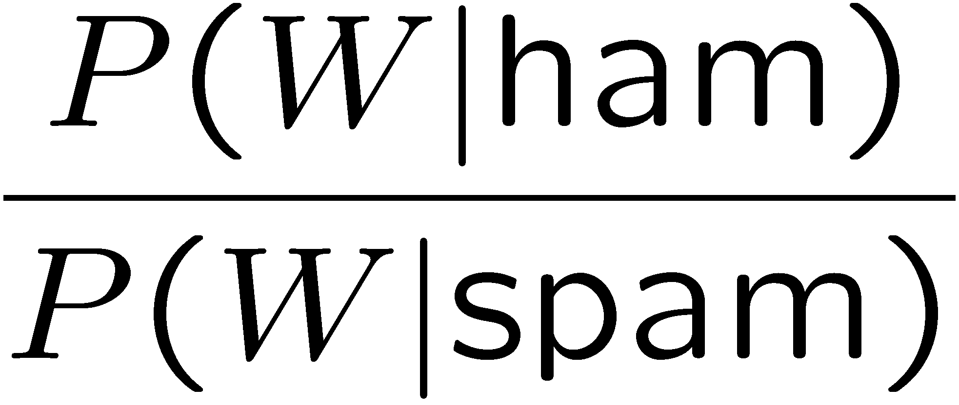
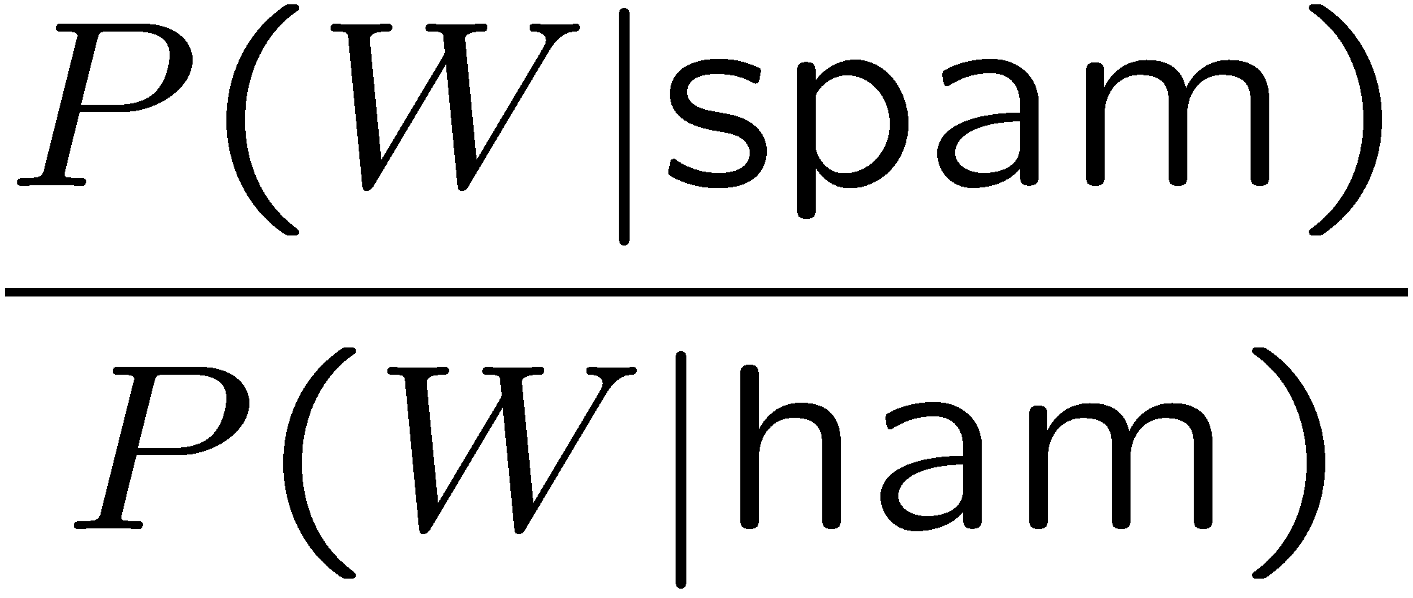
Example: Overfitting
Posteriors determined by relative probabilities (odds ratios):
south-west : inf
nation : inf
morally : inf
nicely : inf
extent : inf
seriously : inf
...
screens : inf
minute : inf
guaranteed : inf
$205.00 : inf
delivery : inf
signature : inf
...
What went wrong here?

Slide 24
Generalization and Overfitting
Relative frequency parameters will overfit the training data!
Just because we never saw a 3 with pixel (15,15) on during training doesn’t mean we won’t see it at test time
Unlikely that every occurrence of “minute” is 100% spam
Unlikely that every occurrence of “seriously” is 100% ham
What about all the words that don’t occur in the training set at all?
In general, we can’t go around giving unseen events zero probability
As an extreme case, imagine using the entire email as the only feature
Would get the training data perfect (if deterministic labeling)
Wouldn’t generalize at all
Just making the bag-of-words assumption gives us some generalization, but isn’t enough
To generalize better: we need to smooth or regularize the estimates

Slide 25
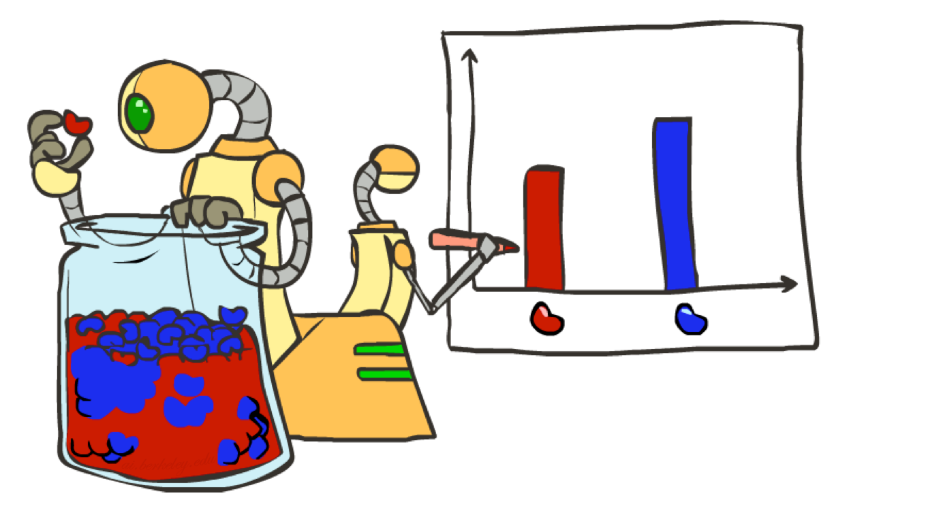
Parameter Estimation

Slide 26
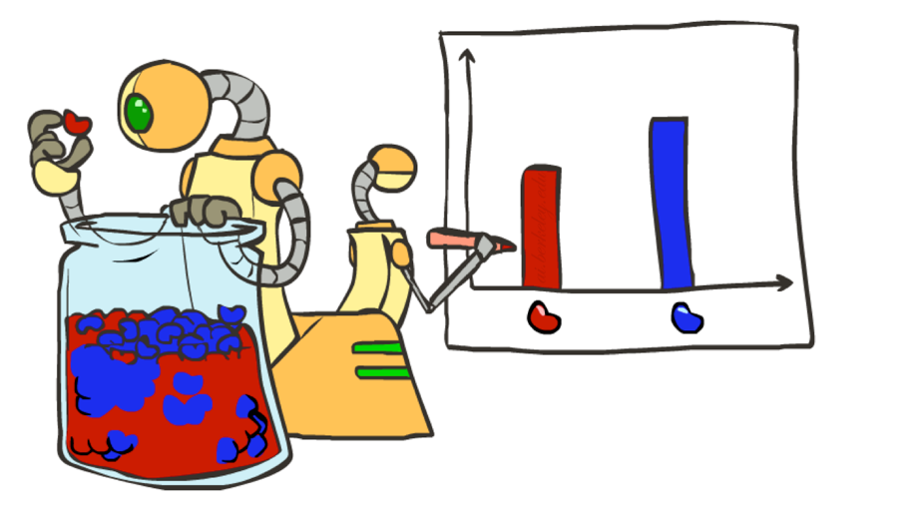
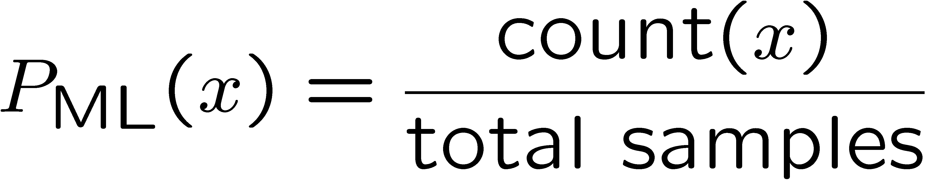
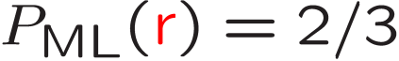
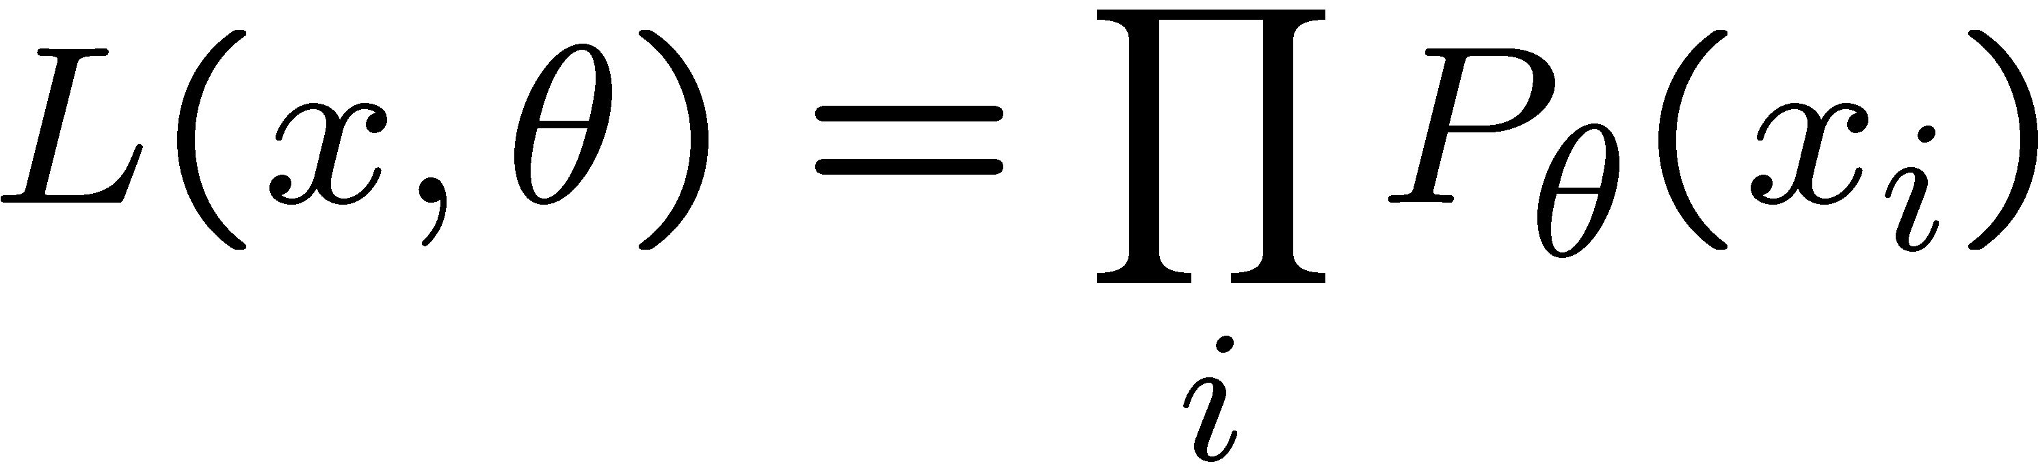
Parameter Estimation
Estimating the distribution of a random variable
Elicitation: ask a human (why is this hard?)
Empirically: use training data (learning!)
E.g.: for each outcome x, look at the empirical rate of that value:
This is the estimate that maximizes the likelihood of the data
r
b
b
b
r
b
b
r
b
r
r
b
b
b
b
r
r
b

Slide 27
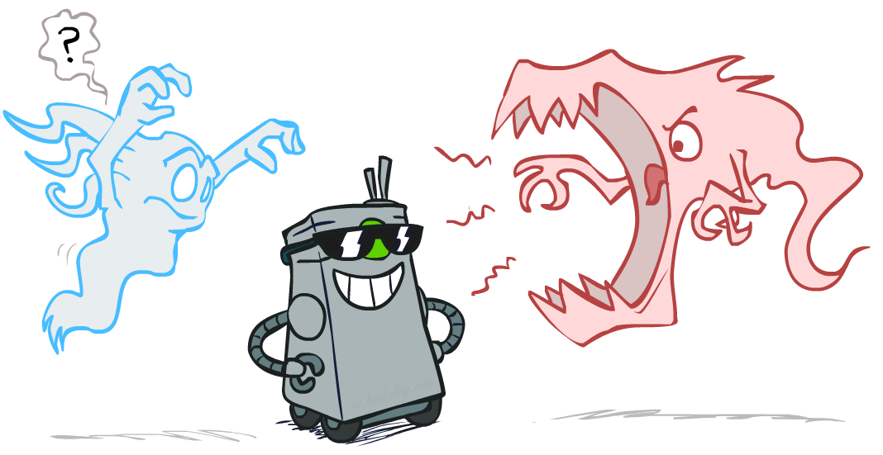
Smoothing

Slide 28
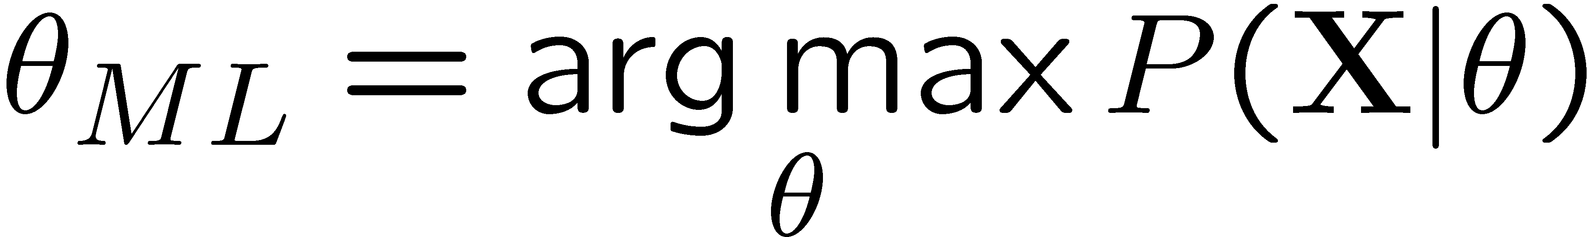




Maximum Likelihood?
Relative frequencies are the maximum likelihood estimates
Another option is to consider the most likely parameter value given the data

Slide 29


Unseen Events

Slide 30




Laplace Smoothing
Laplace’s estimate:
Pretend you saw every outcome once more than you actually did
Can derive this estimate with Dirichlet priors (out of scope)
r
r
b

Slide 31





Laplace Smoothing
Laplace’s estimate (extended):
Pretend you saw every outcome k extra times
What’s Laplace with k = 0?
k is the strength of the prior
Laplace for conditionals:
Smooth each condition independently:
r
r
b

Slide 32
Real NB: Smoothing
For real classification problems, smoothing is critical
New odds ratios:
helvetica : 11.4
seems : 10.8
group : 10.2
ago : 8.4
areas : 8.3
...
verdana : 28.8
Credit : 28.4
ORDER : 27.2
<FONT> : 26.9
money : 26.5
...
Do these make more sense?

Slide 33








Tuning on Held-Out Data
Now we’ve got two kinds of unknowns
Parameters: the probabilities P(X|Y), P(Y)
Hyperparameters: e.g. the amount / type of smoothing to do, k, α
What should we learn where?
Learn parameters from training data
Tune hyperparameters on different data
Why?
For each value of the hyperparameters, train and test on the held-out data
Choose the best value and do a final test on the test data

Slide 34
Summary
Bayes rule lets us do diagnostic queries with causal probabilities
The naïve Bayes assumption takes all features to be independent given the class label
We can build classifiers out of a naïve Bayes model using training data
Smoothing estimates is important in real systems
Classifier confidences are useful, when you can get them

Slide 35
Precision vs. Recall
-
Let’s say we want to classify web pages as
homepages or not
In a test set of 1K pages, there are 3 homepages
Our classifier says they are all non-homepages
99.7 accuracy!
Need new measures for rare positive events
Precision: fraction of guessed positives which were actually positive
Recall: fraction of actual positives which were guessed as positive
Say we guess 5 homepages, of which 2 were actually homepages
Precision: 2 correct / 5 guessed = 0.4
Recall: 2 correct / 3 true = 0.67
Which is more important in customer support email automation?
Which is more important in airport face recognition?
actual +
guessed +

Slide 36




Precision vs. Recall
Precision/recall tradeoff
Often, you can trade off precision and recall
Only works well with weakly calibrated classifiers
To summarize the tradeoff:
Break-even point: precision value when p = r
F-measure: harmonic mean of p and r:

